Slide 1


PageRank Algorithm in Big Data
Dr. Rajiv Misra
Dept. of Computer Science & Engg.
Indian Institute of Technology Patna
rajivm@iitp.ac.in
Big Data Computing
Page Rank

Slide 2
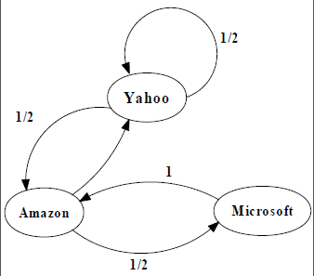
Preface
Content of this Lecture:
In this lecture, we will discuss PageRank Algorithm in Big Data using different framework with different ways and scale.
Big Data Computing
Page Rank

Slide 3
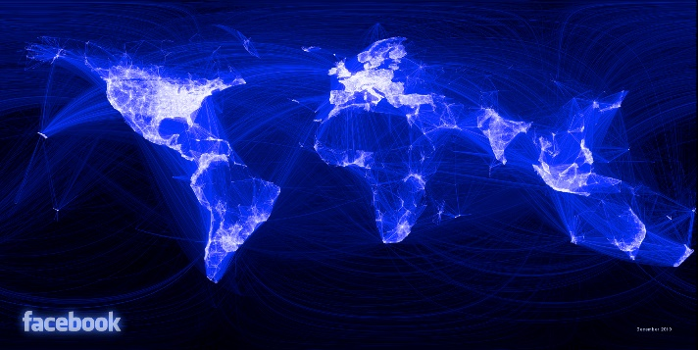
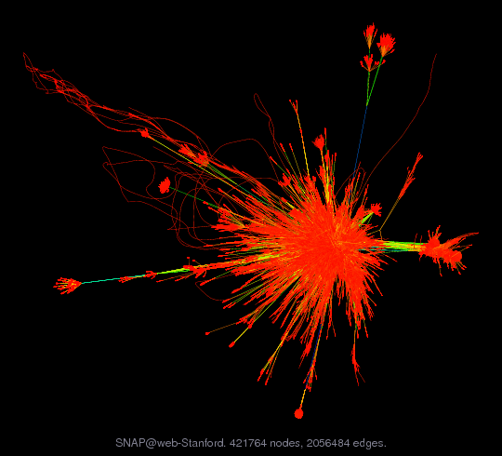
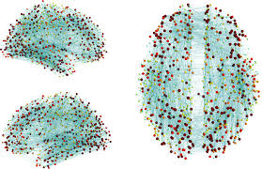
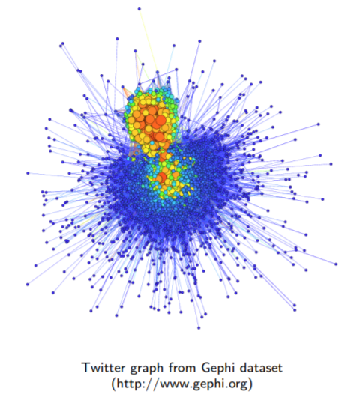
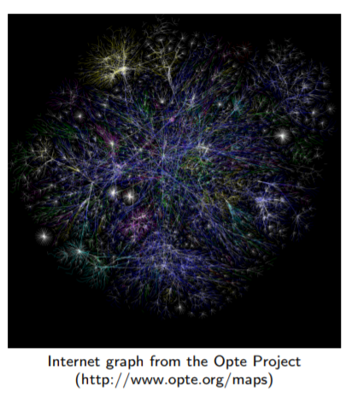
Big Graphs
Social scale graph
1 billion vertices, 100 billion edges
Web scale graph
50 billion vertices, 1 trillion edges
Brain scale graph
100 billion vertices, 100 trillion edges
Social graph from Facebook
https://medium.com/@johnrobb/facebook-the-complete-social-graph-b58157ee6594
Web graph from the SNAP database
https://snap.stanford.edu/data/
Human connectome.
Gerhard et al., Frontiers in Neuroinformatics 5(3), 2011
Big Data Computing
Page Rank

Slide 4
What is PageRank?
Why is Page Importance Rating important?
New challenges for information retrieval on the World Wide Web.
Huge number of web pages: 150 million by1998
1000 billion by 2008
Diversity of web pages: different topics, different quality, etc.
What is PageRank?
A method for rating the importance of web pages objectively and mechanically using the link structure of the web.
History:
PageRank was developed by Larry Page (hence the name Page-Rank) and Sergey Brin.
It is first as part of a research project about a new kind of search engine. That project started in 1995 and led to a functional prototype in 1998.
Big Data Computing
Page Rank

Slide 5
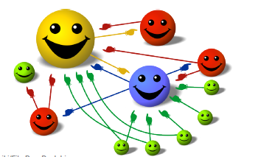
PageRank of E denotes by PR (E)
Give pages ranks (scores) based on links to them
Links from many pages high rank
Links from a high-rank page high rank
Big Data Computing
Page Rank

Slide 6
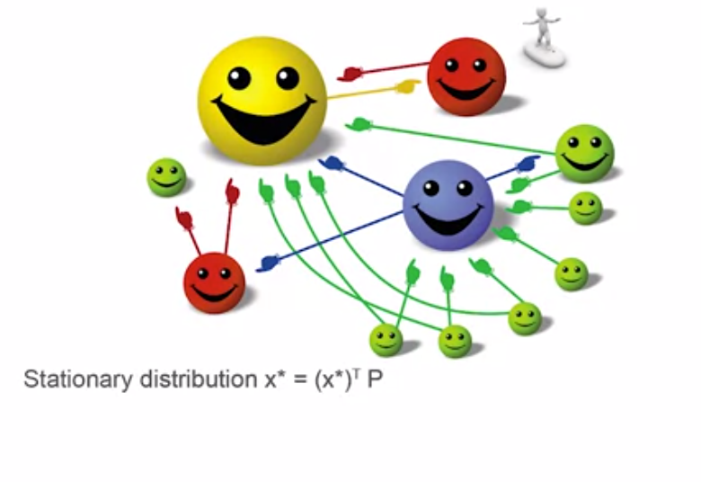
PageRank of E denotes by PR (E)
Big Data Computing
Page Rank

Slide 7
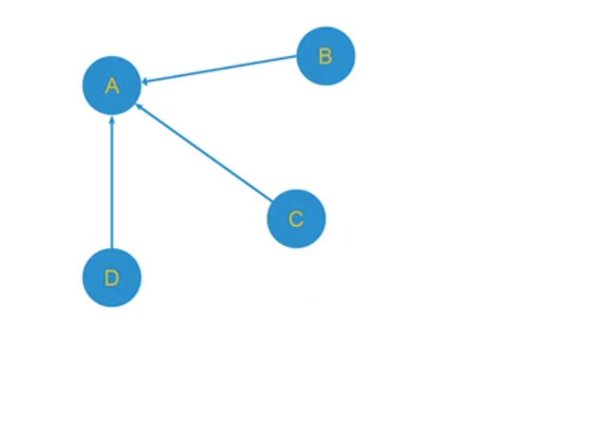
Example
Big Data Computing
Page Rank

Slide 8
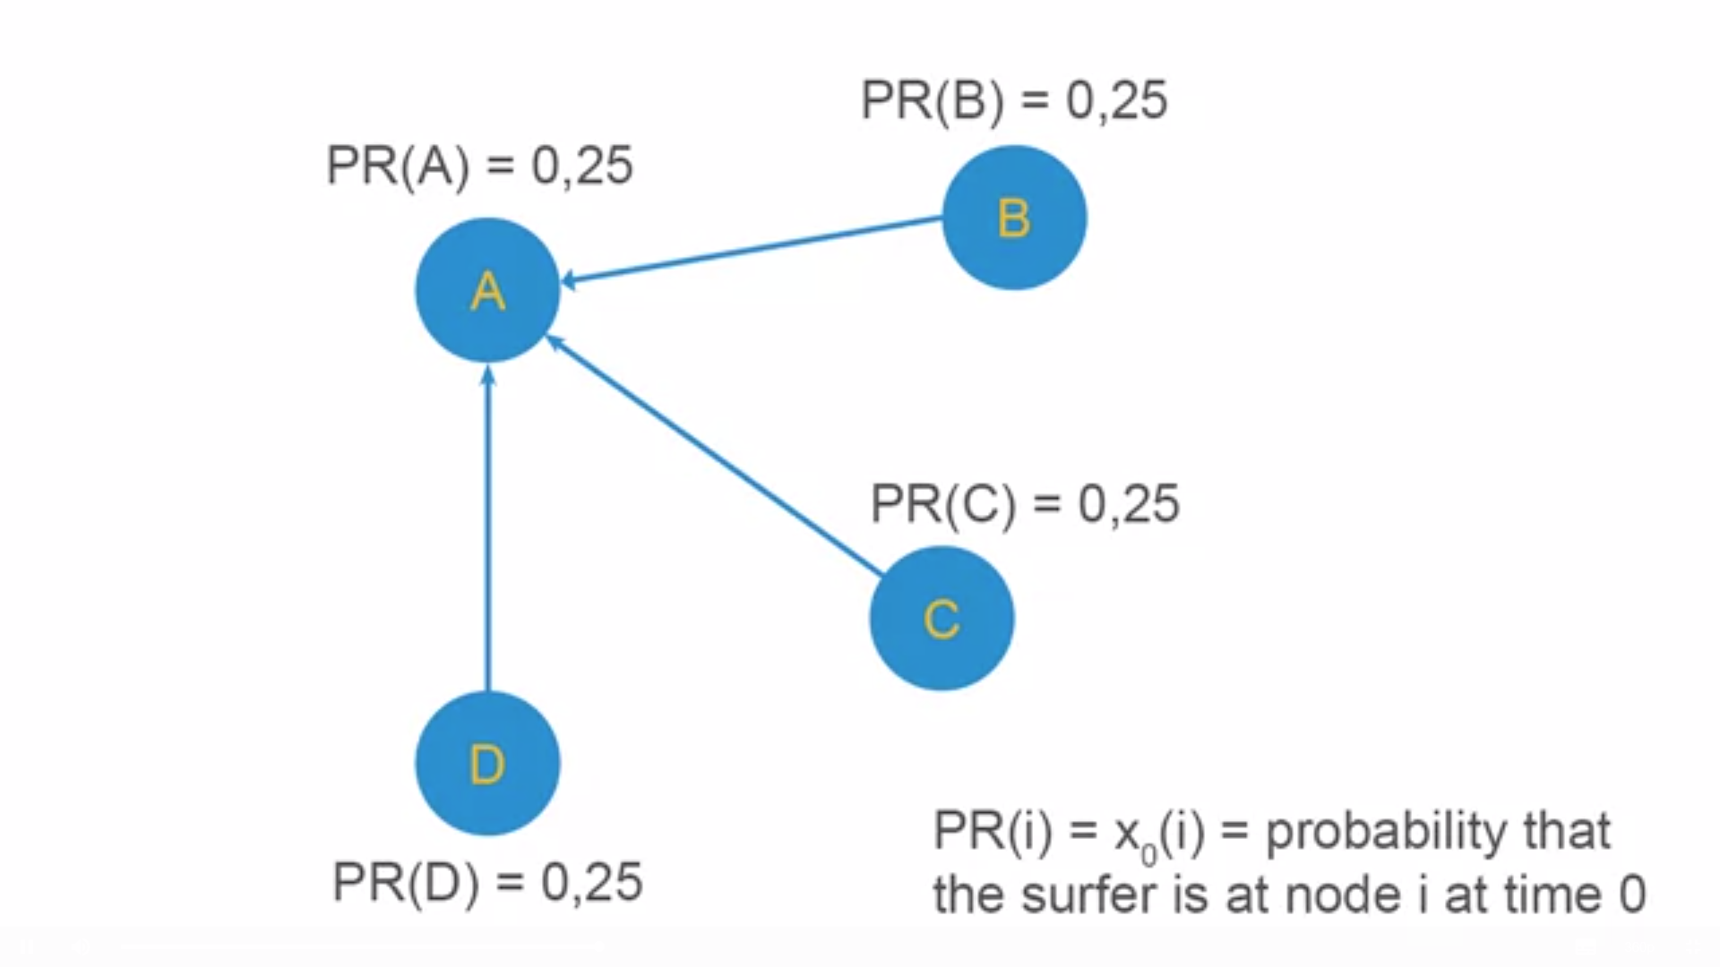
Example
Big Data Computing
Page Rank

Slide 9
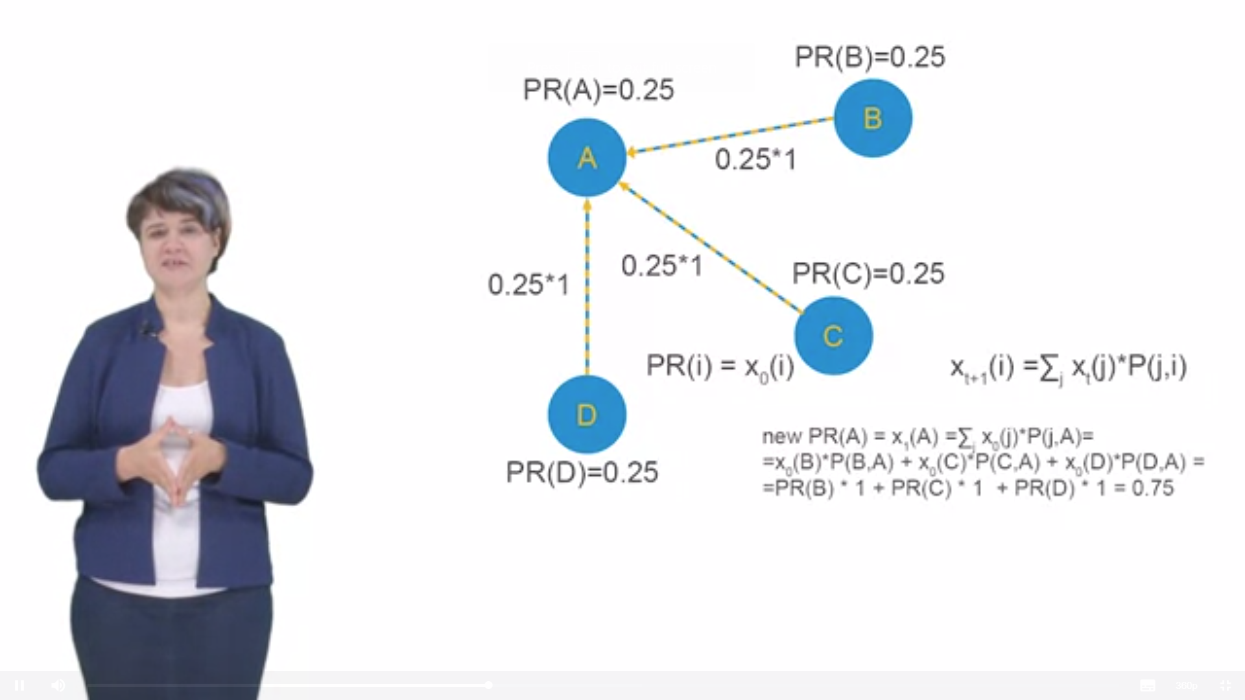
Example
Big Data Computing
Page Rank

Slide 10
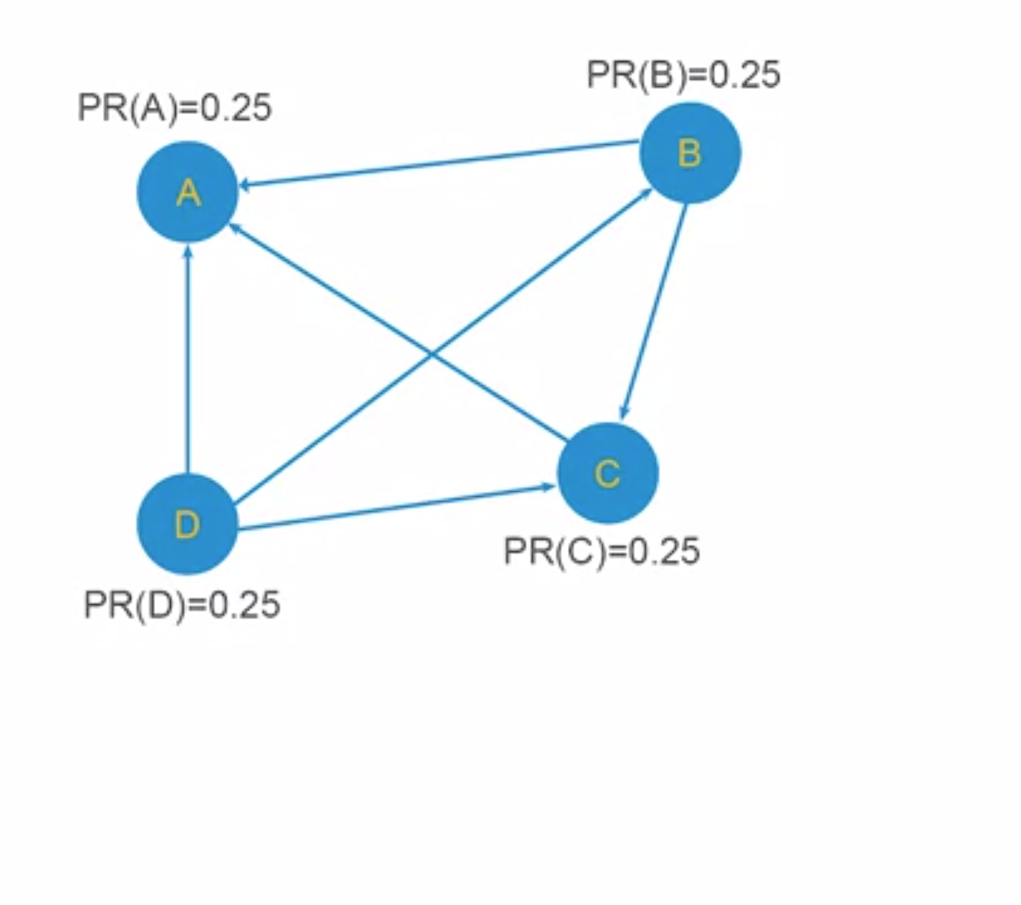
Example
Big Data Computing
Page Rank

Slide 11
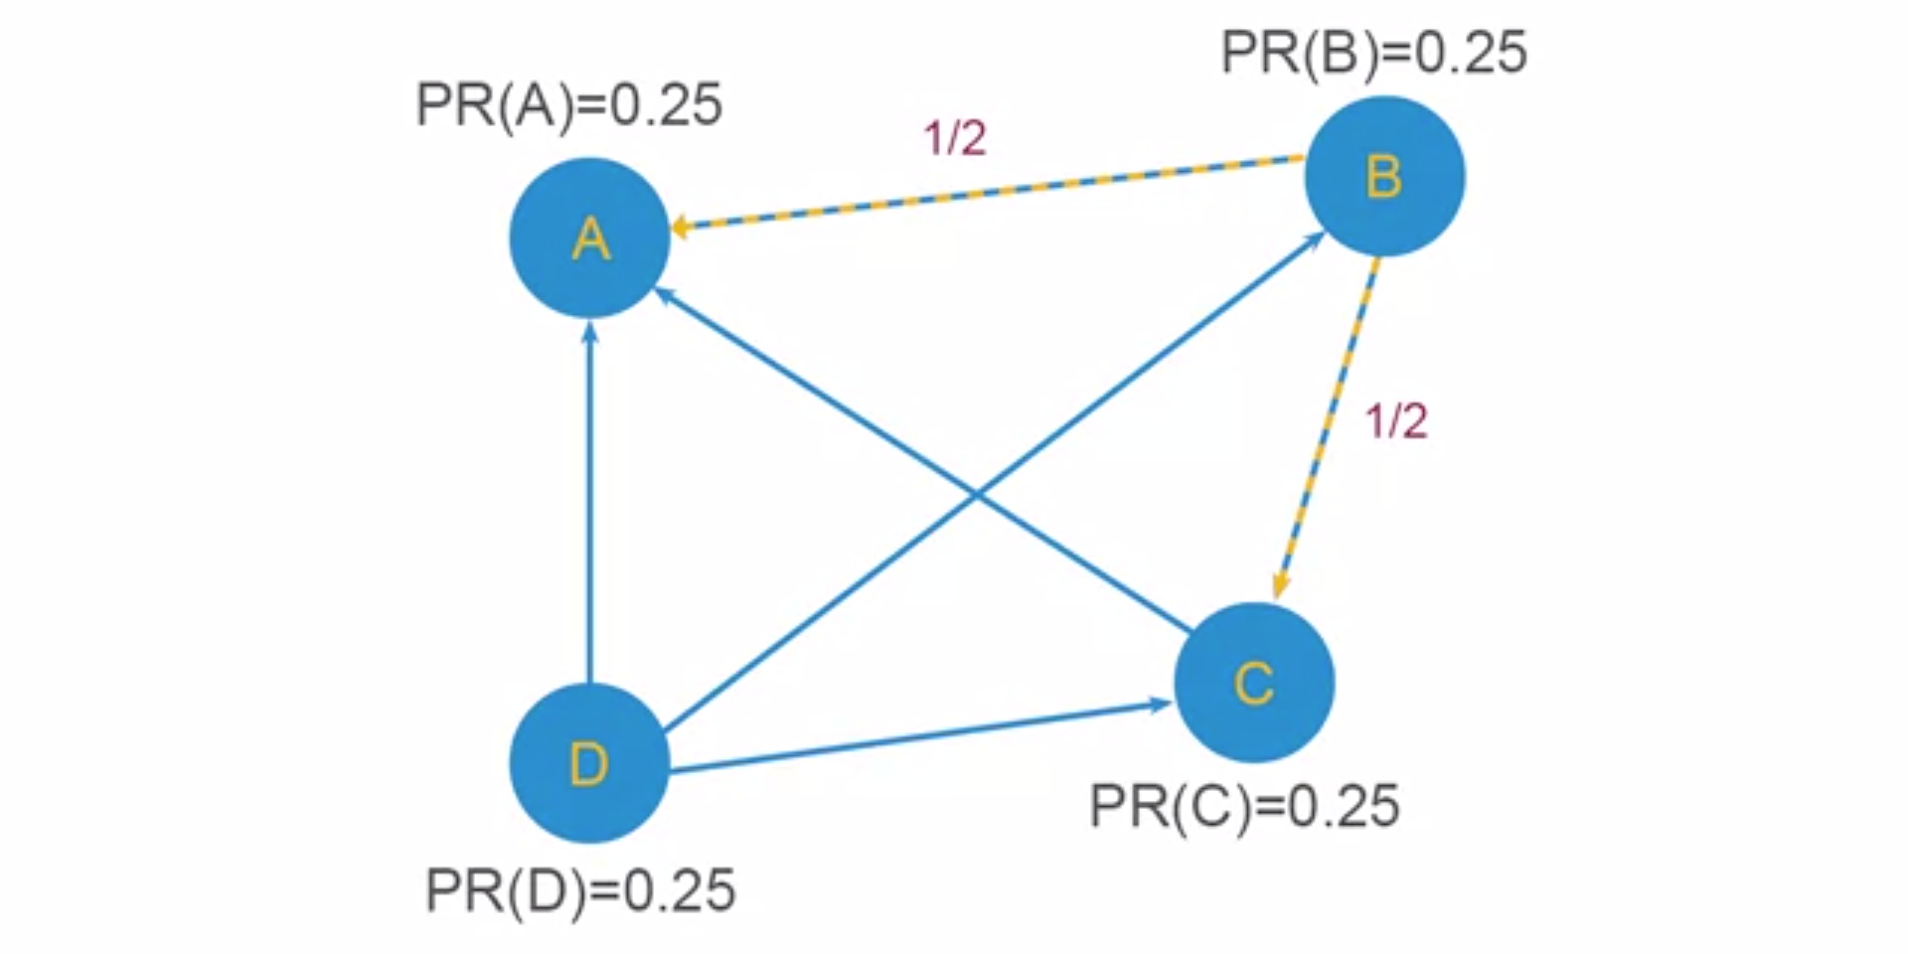
Example
Big Data Computing
Page Rank

Slide 12
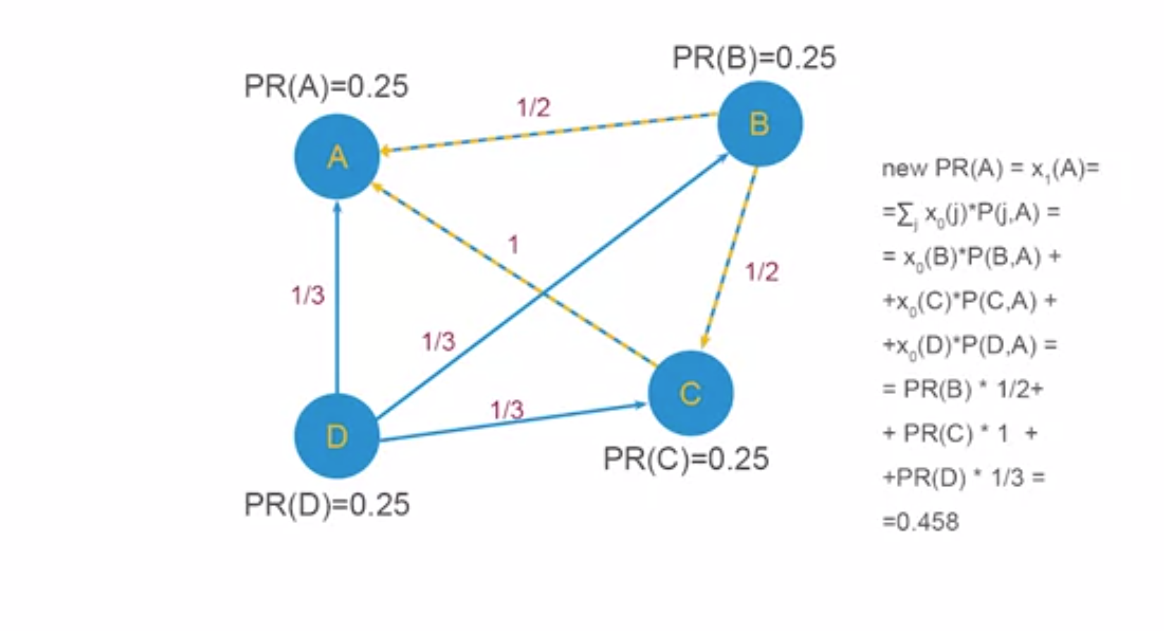
Example
Big Data Computing
Page Rank

Slide 13
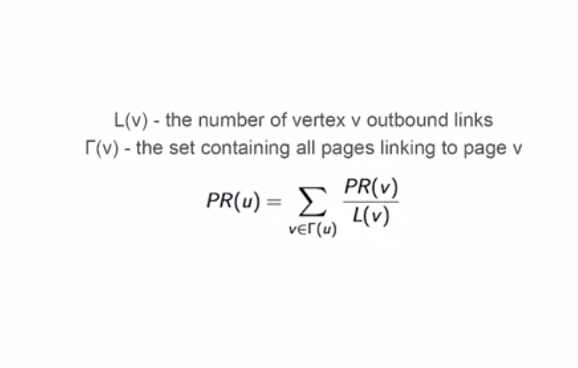
Page Rank
Big Data Computing
Page Rank

Slide 14
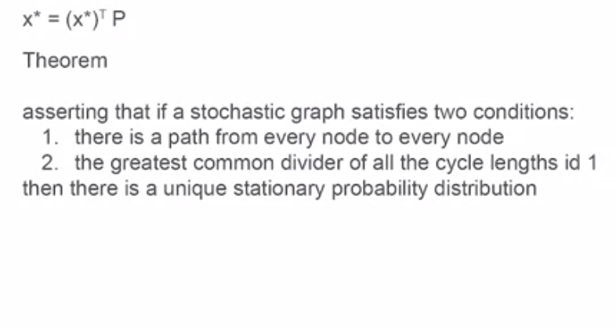
Stationary Distribution
Big Data Computing
Page Rank

Slide 15
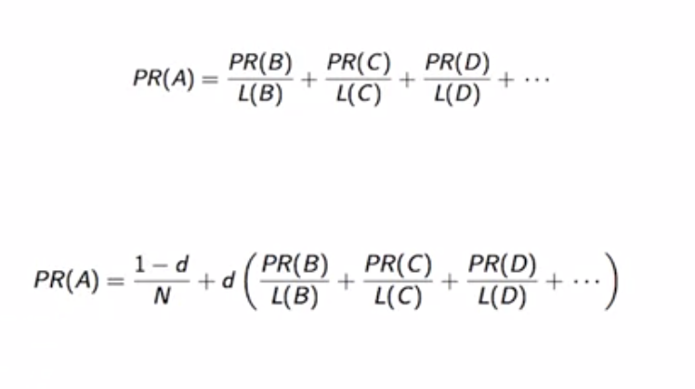
Page Rank
Big Data Computing
Page Rank

Slide 16
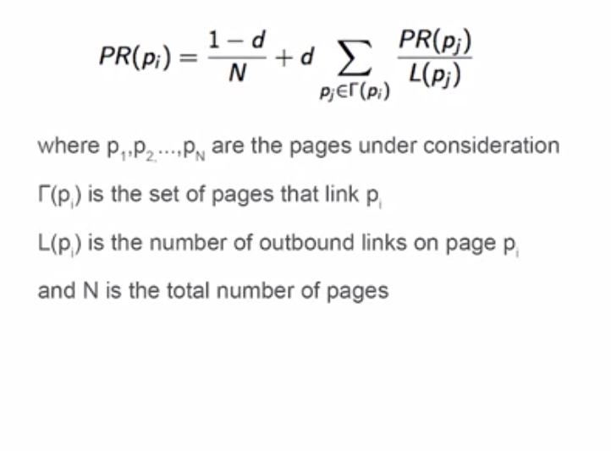
Page Rank
Big Data Computing
Page Rank

Slide 17
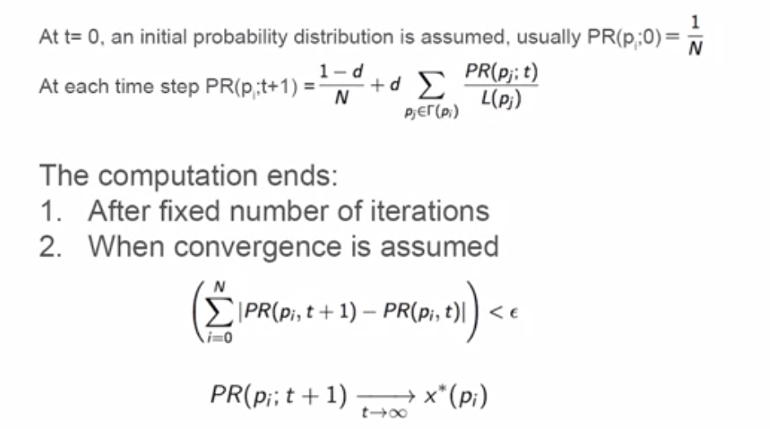
Page Rank
Big Data Computing
Page Rank

Slide 18
Summary
PageRank (PR)- a first algorithm by Google Search to rank websites in their search engine results.
We have shown how to calculate iteratively PageRank for every vertex in the given graph.
Big Data Computing
Page Rank

Slide 19
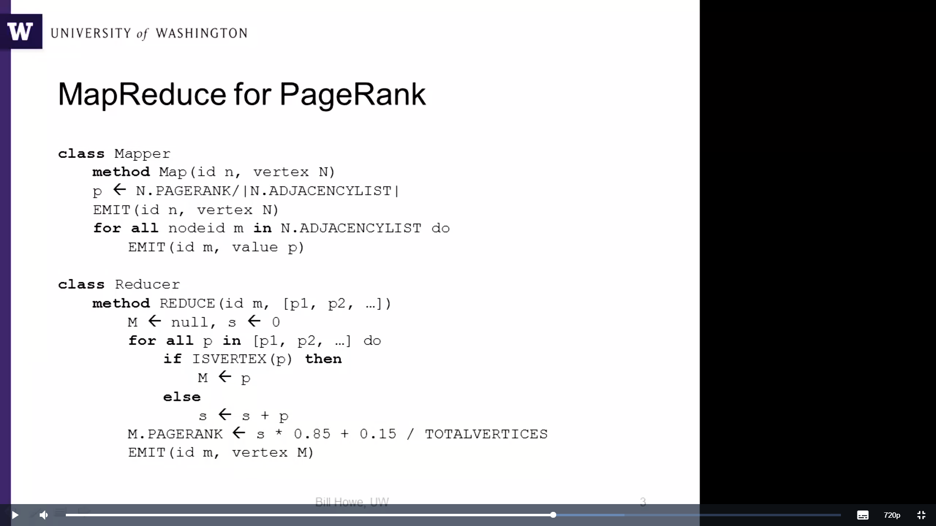
MapReduce for PageRank
Big Data Computing
Page Rank

Slide 20
Problems
The entire state of the graph is shuffled on every iteration
We only need to shuffle the new rank contributions, not the graph structure
Further, we have to control the iteration outside of MapReduce
Big Data Computing
Page Rank

Slide 21
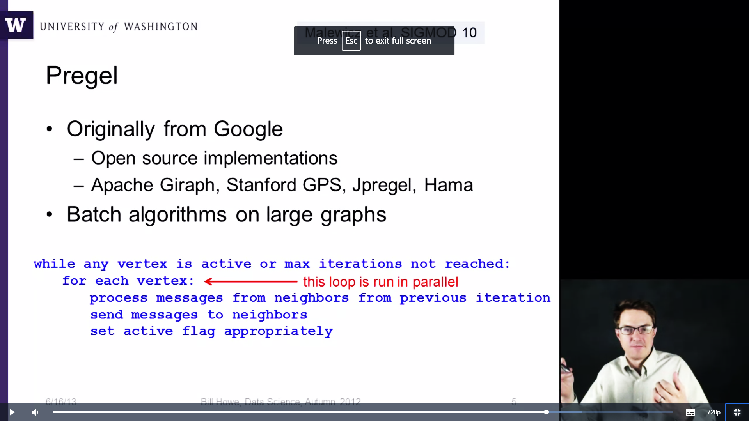
Pregel
Originally from Google
Open source implementations
Apache Giraph, Standard GPS, Jpregel, Hama
Batch algorithms on large graphs
Big Data Computing
Page Rank

Slide 22
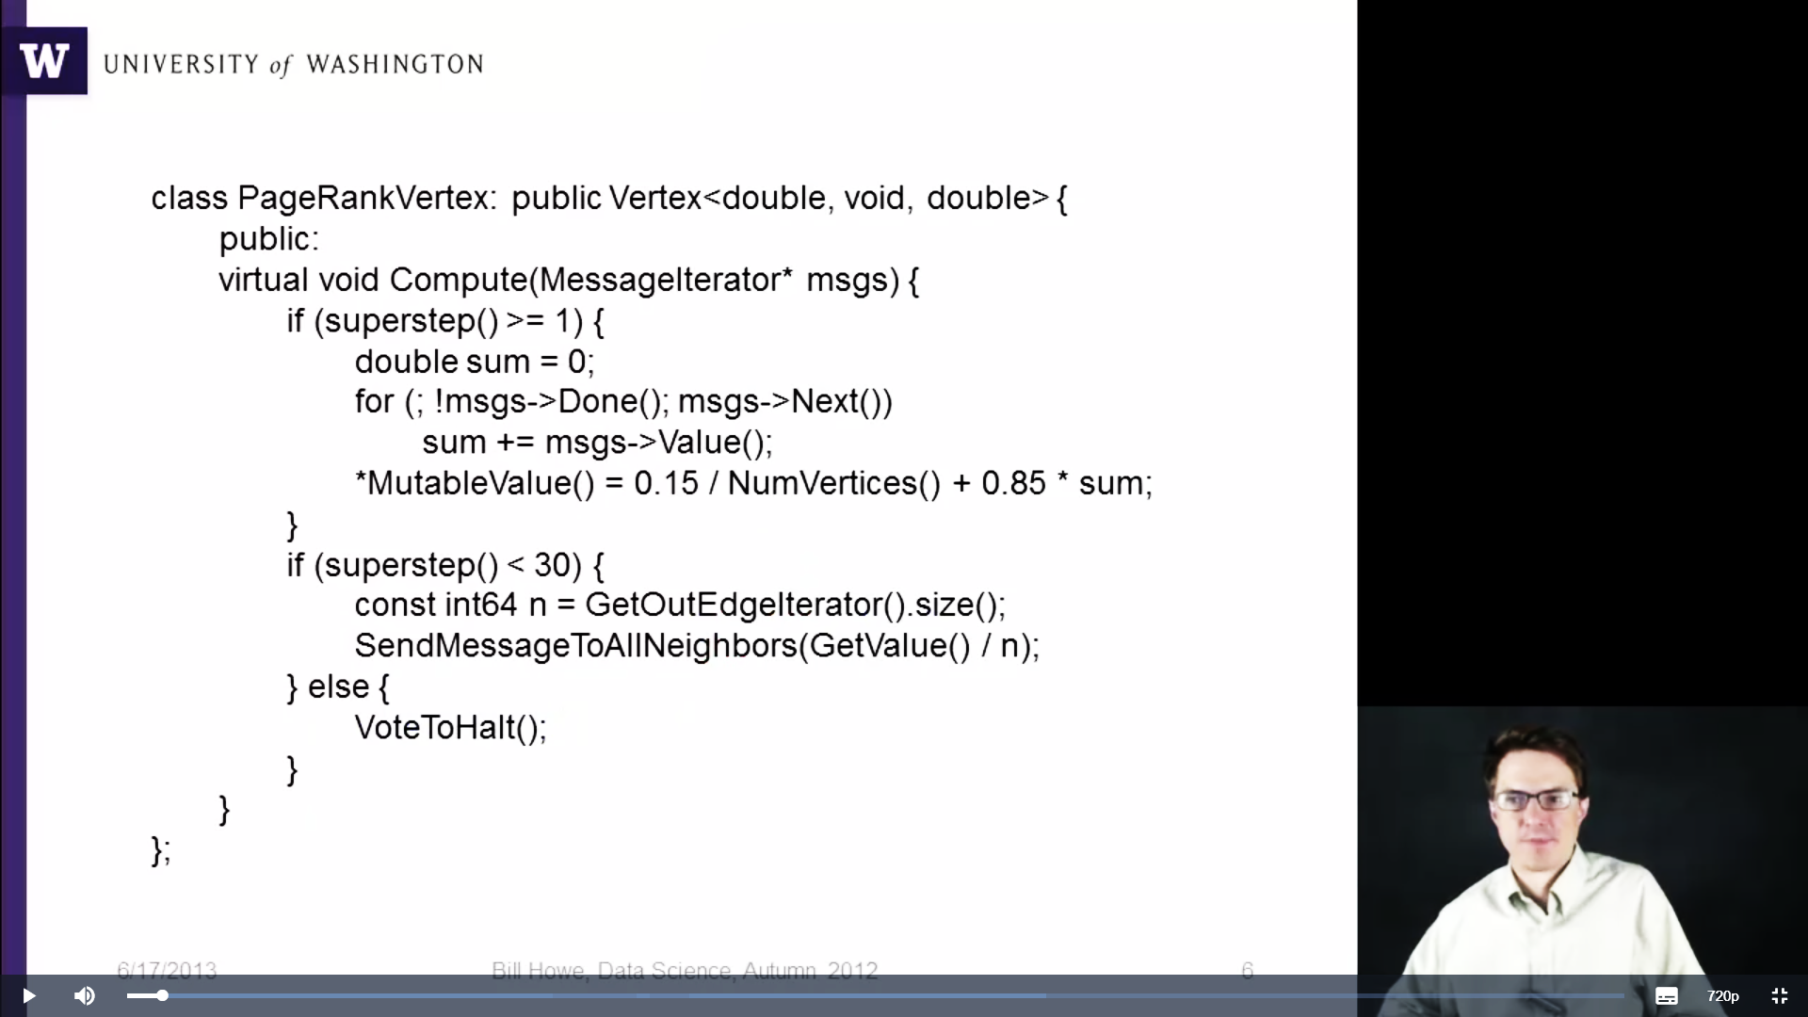
PageRank in Pregel
Big Data Computing
Page Rank

Slide 23
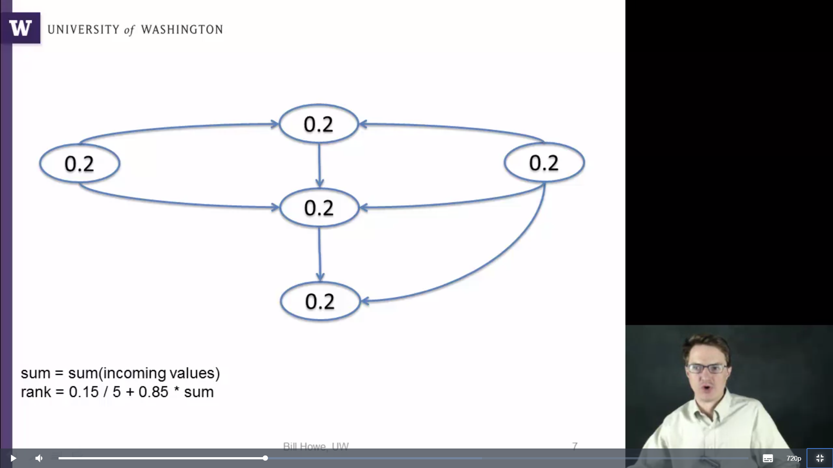
Example
Big Data Computing
Page Rank

Slide 24
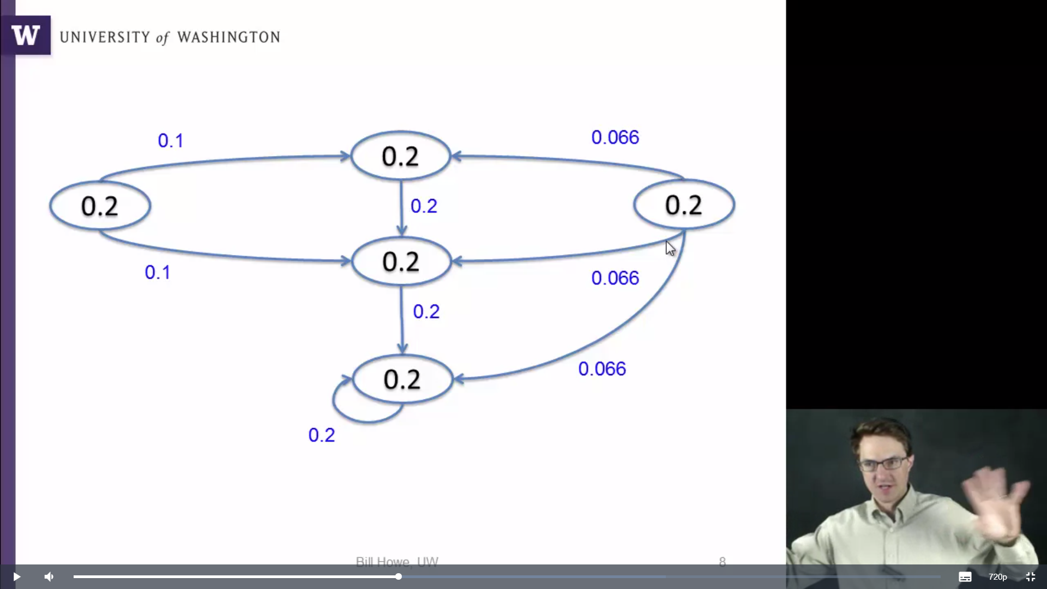
Example
Big Data Computing
Page Rank

Slide 25
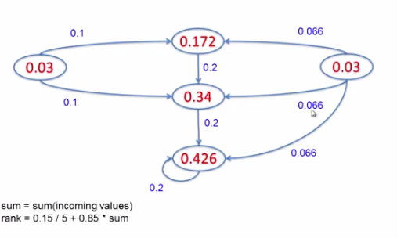
Example
Big Data Computing
Page Rank

Slide 26
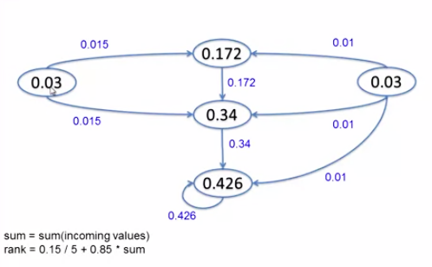
Example
Big Data Computing
Page Rank

Slide 27
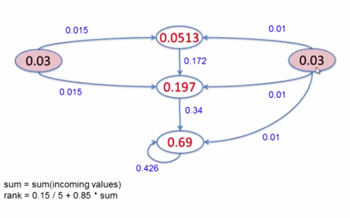
Example
Big Data Computing
Page Rank

Slide 28
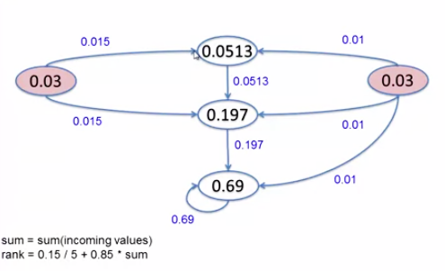
Example
Big Data Computing
Page Rank

Slide 29
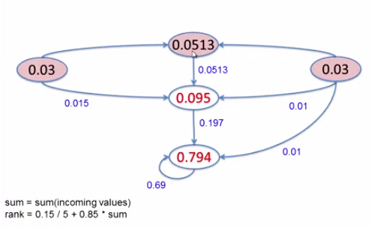
Example
Big Data Computing
Page Rank

Slide 30
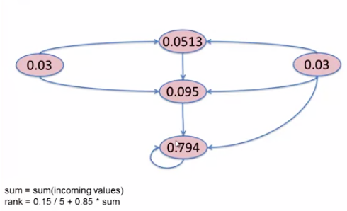
Example
Big Data Computing
Page Rank

Slide 31
Conclusion
Graph-structured data are increasingly common in data science contexts due to their ubiquity in modeling the communication between entities: people (social networks), computers (Internet communication), cities and countries (transportation networks), or corporations (financial transactions).
In this lecture, we have discussed PageRank algorithms for extracting information from graph data using MapReduce and Pregel.
Big Data Computing
Page Rank

